Slide 1
cylinder
(0.5,1)
front
back
(0,0.5)
side
(0,0)

Slide 2


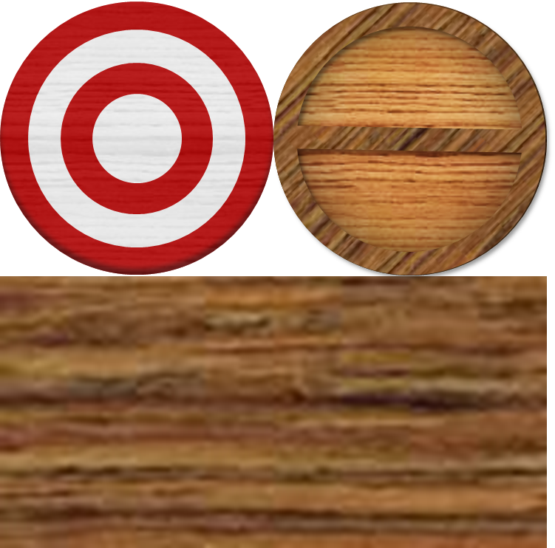

Cylinder-example

Slide 3
cone
(0.5,1)
side
buttom
(0,0.5)
none
(0,0)

Slide 4
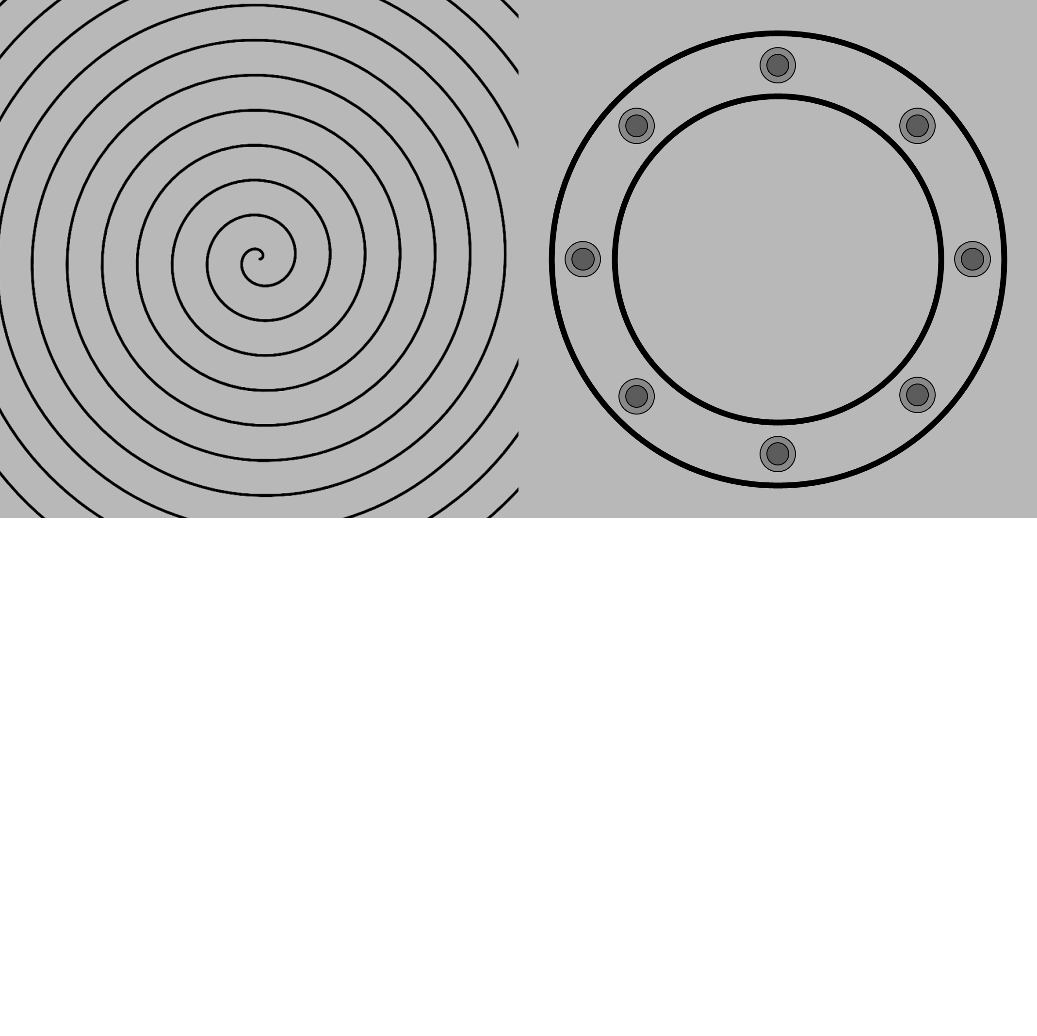
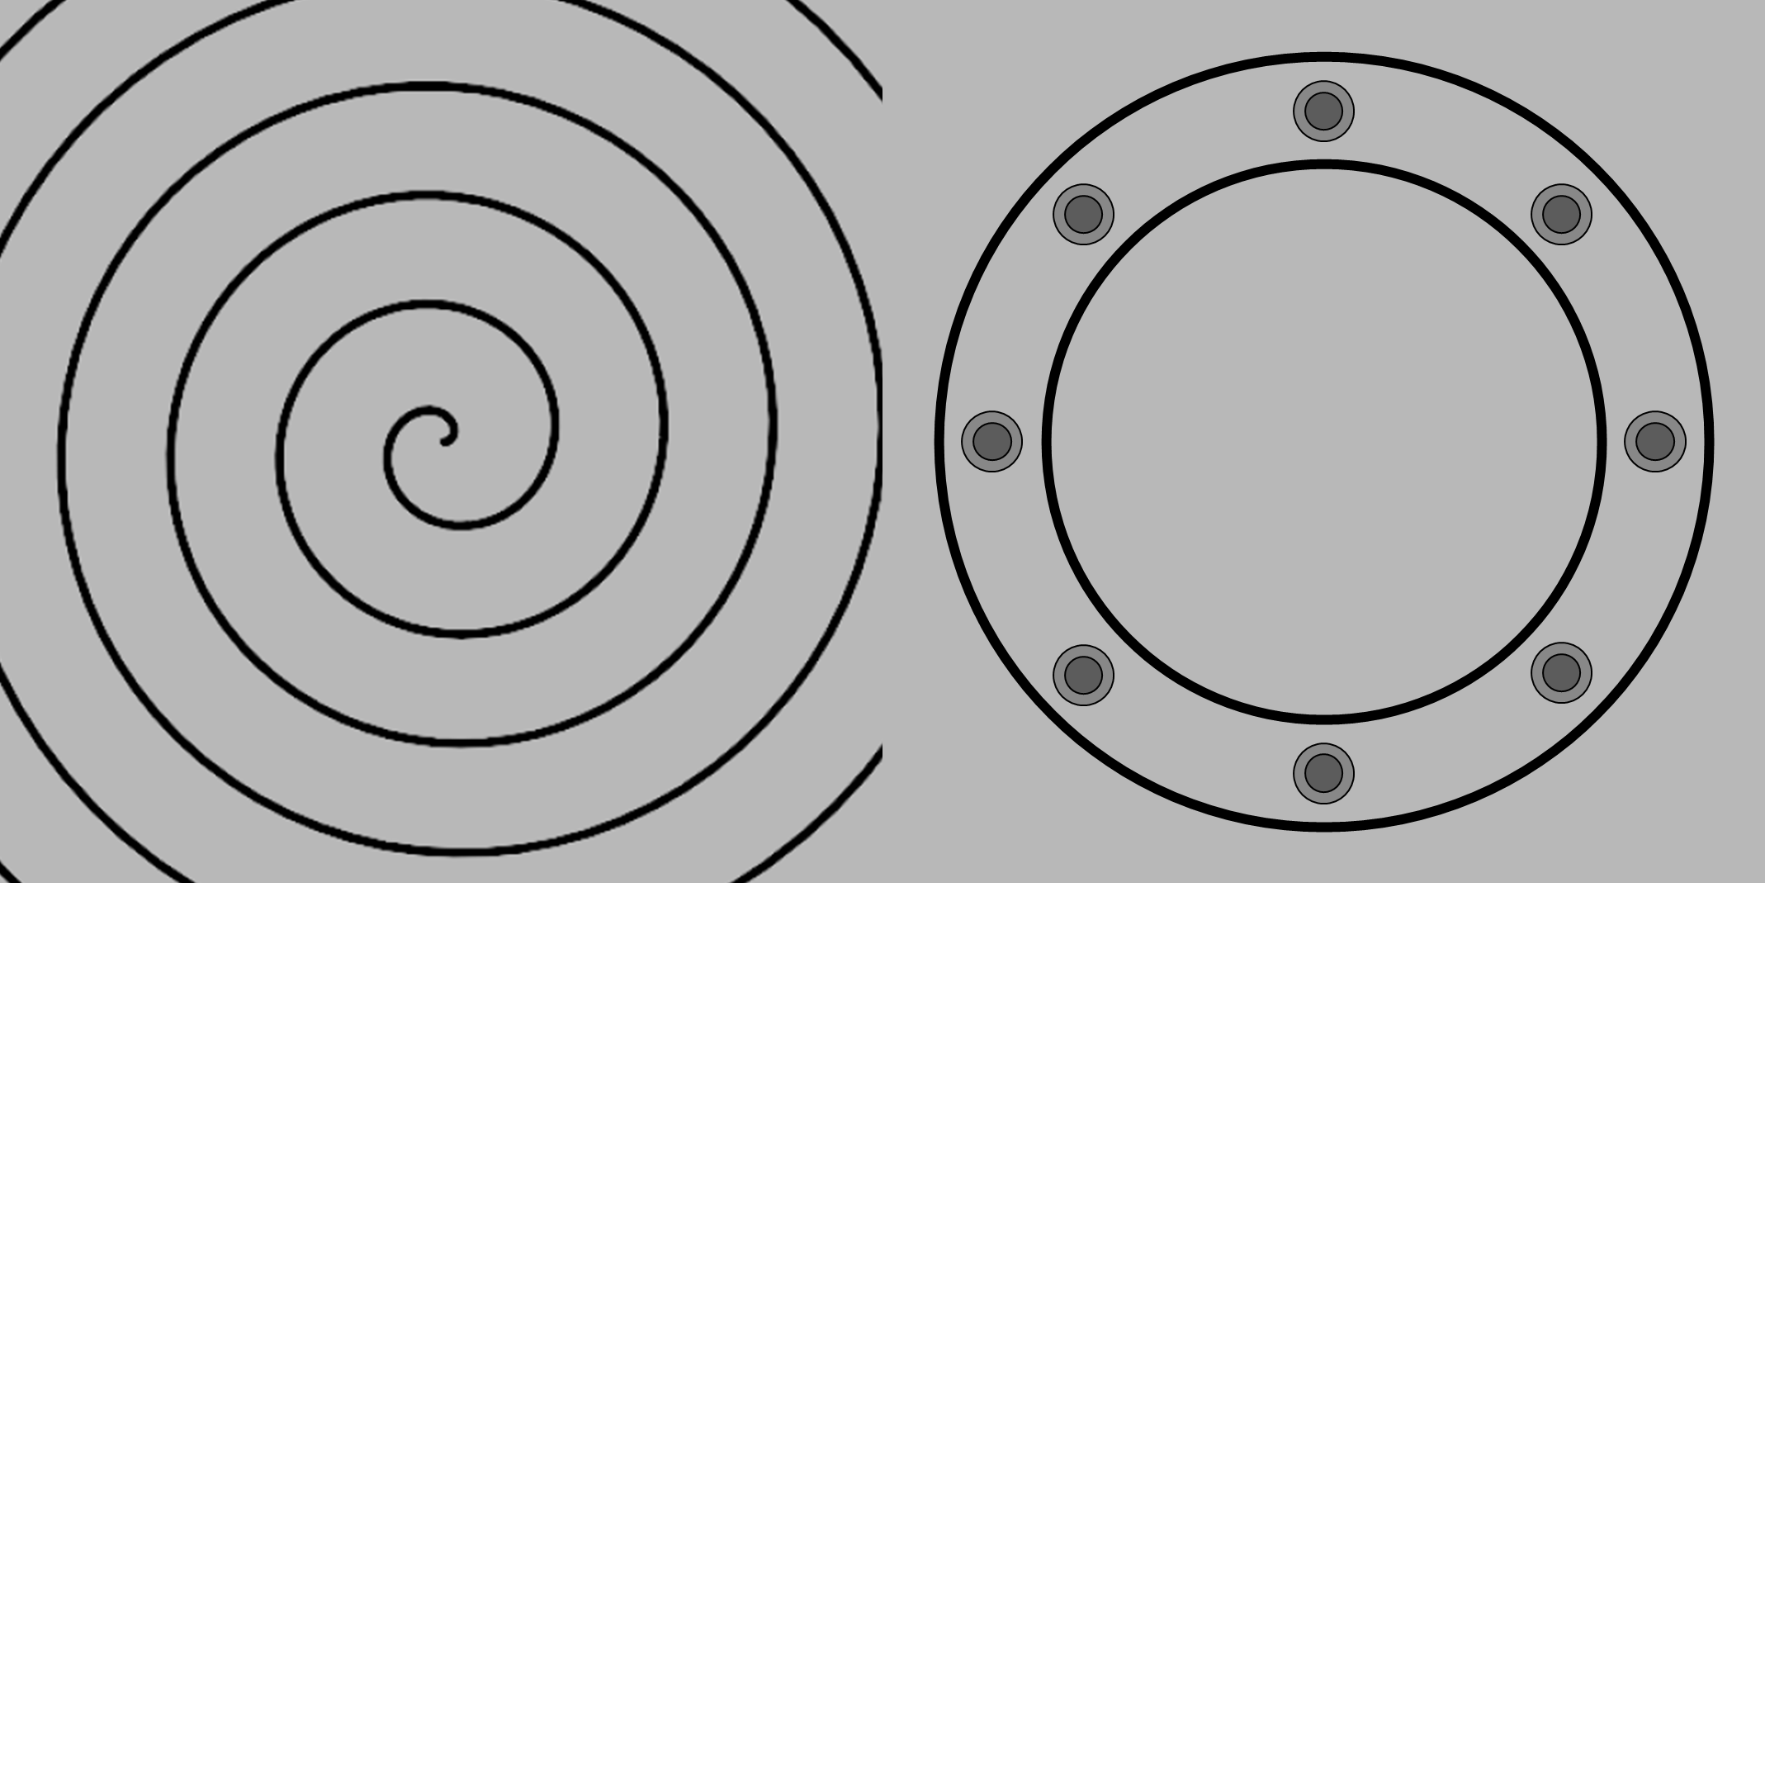

Cone-example

